Slide 1

Autism Detection System

Slide 2

Project Leadership
Sharat Manikonda
Director at Innodatatics and Sponsor
linkedin.com/in/sharat-chandra

Slide 3
Team Members
Name:Aditi Bolakhe
https://www.linkedin.com/profilelink

Slide 4

Contents
Business objective
Business Constraints
Project Architecture
Data collection and details
Exploratory Data Analysis
Visualization
Modeling
Evaluation
Deployment
Notes:
Change

Slide 5
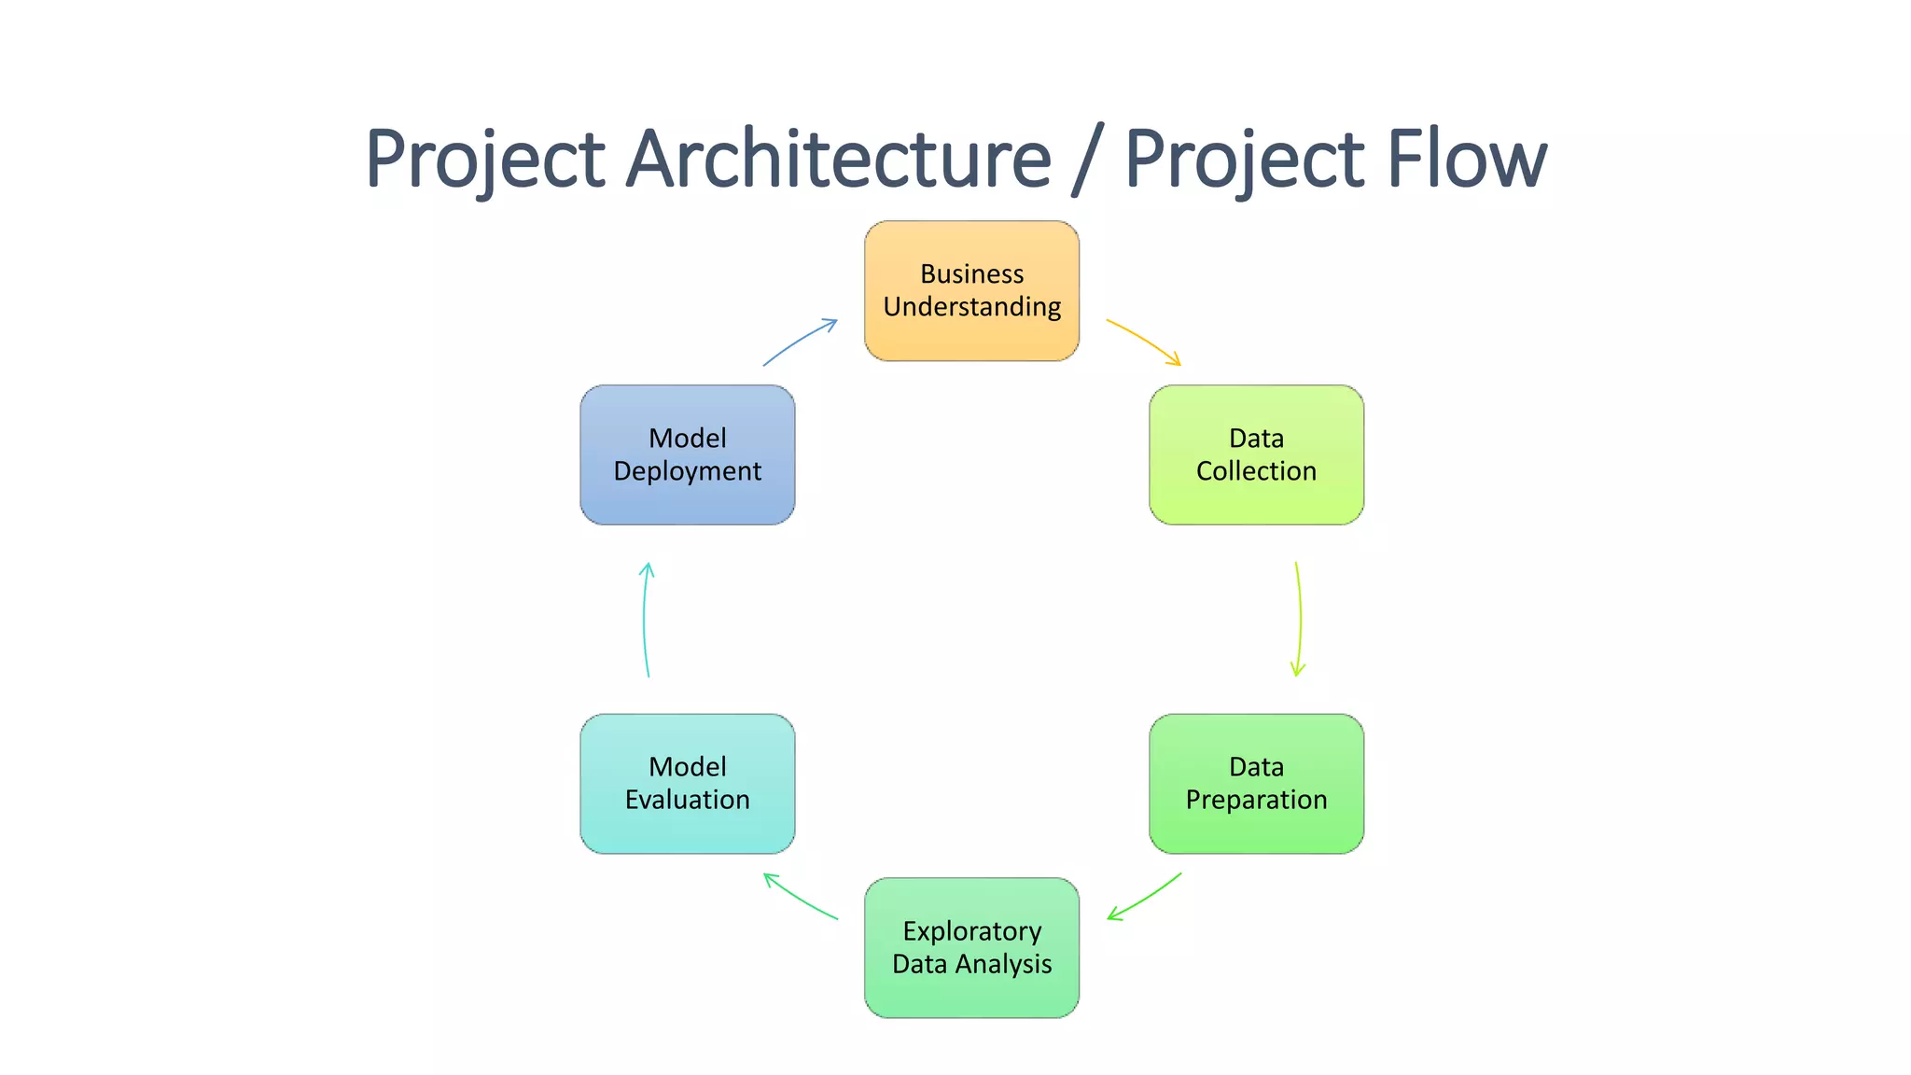
Project Overview and Scope

Slide 6
Business Problem
Autism is going undetected .Autism related behaviour increasing in the day by day.

Slide 7
Business Objective
Objective
Constraints
Reduce the manual effort
Maximize the early detection of autism

Slide 8
CRISP-ML(Q) Methodology
There are six stages of CRISP-ML(Q) Methodology
1.Business and data understanding
2.Data preparation
3.model building
4.Model evaluation
5.Model deployment
6.Monitoring and maintenance

Slide 9
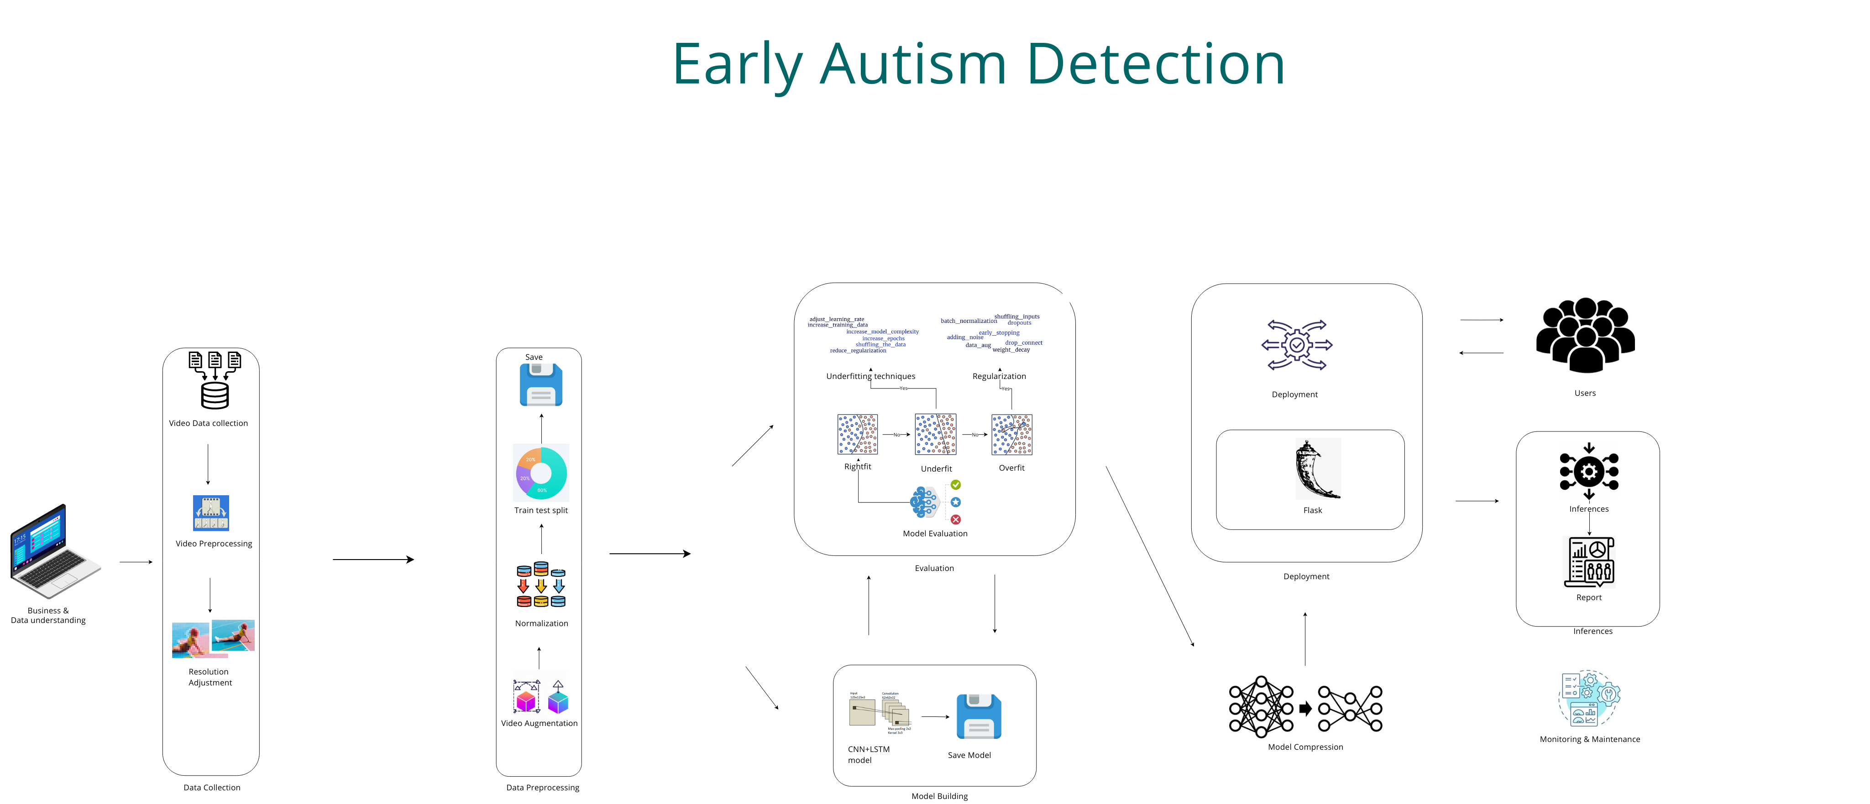
Technical Stacks and Project Architechture

Slide 10
Data Collection and Understanding
Collected the data from various websites and youtube on Autism

Slide 11
Data Information
3 classes assigned to me a)Sensory_Avoidance
b)Run&Walk
c)Finger_Sucking

Slide 12
System Requirements
Streamlit
TensorFLow
ComputerVison2
Numpy
MatPlotLib

Slide 13
Data Preprocessing
10 sec each video split
Splitting videos into 10-second segments helps standardize video data for machine learning. This process divides each video into uniform chunks of 10 seconds, making it easier for models to handle and learn from. By doing this, you ensure that each segment has the same duration, which improves consistency and efficiency during training. This approach helps models better capture and analyze patterns over time.

Slide 14
Model Building
The model uses ResNet50V2 and LSTM to leverage both spatial and temporal features from video data. ResNet50V2, a deep convolutional network, extracts rich spatial features from each frame by learning hierarchical patterns in images. These features are then fed into an LSTM (Long Short-Term Memory) network, which captures temporal dependencies and patterns across consecutive frames. This combination allows the model to effectively analyze both the detailed content of individual frames and the dynamic changes over time, making it well-suited for video classification tasks.
Notes:
classification is the task of predicting a discrete class label. Regression is the task of predicting a continuous quantity.
What is classification techniques in machine learning?
The Classification algorithm is a Supervised Learning technique that is used to identify the category of new observations on the basis of training data. In Classification, a program learns from the given dataset or observations and then classifies new observation into several classes or groups.
What is regression techniques in machine learning?
Regression is a technique for investigating the relationship between independent variables or features and a dependent variable or outcome. It's used as a method for predictive modeling in machine learning, in which an algorithm is used to predict continuous outcomes.

Slide 15
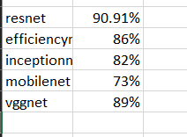
Model Accuracy Comparison

Slide 16
Best Model –
RESNET WITH LSTM- ACCURACY:90%
Notes:
Why Random Forest Regression is good?
A Random Forest Regression model is powerful and accurate. It usually performs great on many problems, including features with non-linear relationships
How is XGBoost different from random forest?
One of the most important differences between XG Boost and Random forest is that the XGBoost always gives more importance to functional space when reducing the cost of a model while Random Forest tries to give more preferences to hyperparameters to optimize the model..
n_estimators — the number of decision trees you will be running in the model

Slide 17

Model Deployment - Strategy

Slide 18
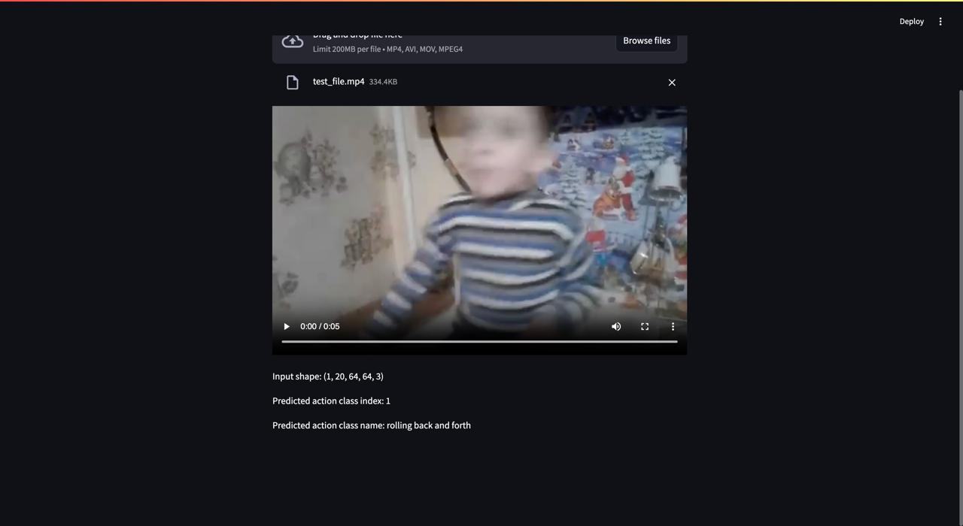
Screen shot of output

Slide 19
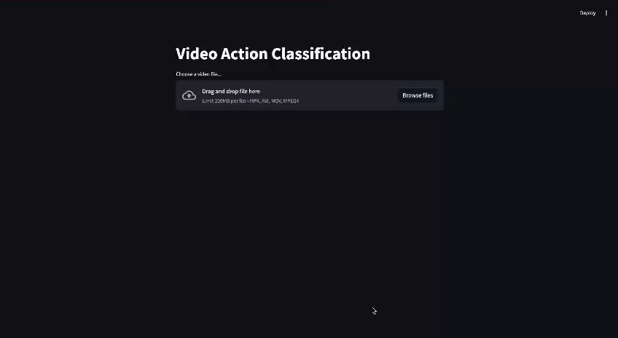
Video of output

Slide 20

Queries ?

Slide 21


